Slide 1
Programming Fundamentals Fall 2021
Introductory Lecture 1
Dr. Farhan Aadil
farhan.aadil@ciit-attock.edu.pk
DrAadil.com
Please turn OFF your Mobile Phones!

Slide 2
Introductory Session
Instructor’s Intro
Consultation hours
General University Rules
Course Intro
Programing intro

Slide 3
Consultation Hours
3 hours a week (equal to teaching time) are reserved for student counseling. You are encouraged to bring your problems to me ONLY during these consultation hours.
It is advised to come in groups of 3 – 4 students if possible.
If you come to MY room:
Be respectful.
Come with a definitive purpose.
Be to the point.
All course related questions should be specific. Vague and casual questions are not treated.
Individual favors are never granted!

Slide 4
Consultation hours….
My Office:
Room # 51, Ground Floor, Computer Science Department,
My Email:
Email: farhan.aadil@ciit-attock.edu.pk
(other means of consultation are discouraged)
Day | Time
Monday | 9:30 AM to 11:00 AM
Wednesday | 9:00 AM to 10:30 AM

Slide 5
General University Rules
Dress Code: Students not conforming to the prescribed dress-code will not be allowed to sit in class/lab as per university policy (from week-1 onwards).
Expected to be decent and modest, in accordance with local cultural values. Must not be provocative or indecent.
Shorts, sleeveless shirts, tight or see-through dresses, heavy make-up, expensive jewelry are not allowed.
Attendance: Greater than 80% attendance REQUIRED!
Questions: Topic related questions are appreciated during the lecture.
Disturbance in class: ‘Nothing’ which ‘disturbs’ will be tolerated!
Mobile Phone in Class: You will be marked absent in your mobile phone rings.
Smoking: This is a non-smoking campus. You can be fined heavily if caught smoking.

Slide 6
Plagiarism/Cheating
University has ‘zero tolerance’ policy for cheating!
Can earn you a punishment from getting zero in the cheated stuff to awarding an F grade in the whole course to expulsion from university based on the severity of the act.
In this course, a student found guilty of cheating in an assignment/quiz/project will be awarded ZERO in that exam.
A student marked as a cheater twice in assignments will get ZERO in all assignments.
Further attempt to cheating will be referred to the DC.
Exam cheating cases go to DC which generally awards a minimum of an F grade in the whole course if proven guilty.

Slide 7
Repeating a course…
Students who fail a course (get an F grade) or pass with D or D+ generally have to repeat it.
This may put him behind his class fellows and may possibly extend the duration of the degree.
Repeat courses have stricter grading policy.
Remember your transcript (detailed marks sheet) shows details of every course taken and grade earned.
If a course is failed, it will get mentioned in the transcript. If it is repeated, it will be mentioned.

Slide 8
Time Management …
Manage your time well while on campus, during travel and at home! Utilize the maximum NOW instead of getting to full throttle near exams without much benefit!
Identify your weaknesses and strengths and work accordingly.
It is recommended that:
Be attentive in the class.
In the first possible free time, do a ‘few problems’ related to the topic(s) covered in class.
If you can do it, it means you got the point; if not, at least you know what you do not know. Ask the teacher in the next class.
At the weekend, sum up all the week’s study.

Slide 9
Programming Fundamentals Fall 2021
Introductory Lecture 1(a)
Dr. Farhan Aadil
farhan.aadil@ciit-attock.edu.pk
DrAadil.com
Please turn OFF your Mobile Phones!

Slide 10
Course Introduction (Marks Distribution) …
 | Theory | Lab
Assignments | 7.5 | 15
Quizzes | 7.5 | -
Class/Lab Participation |  | 10
Project / Presentations | 10 | 25
Total | 25 | 50
Midterm | 25 | 25
Final Exam | 50 | 25
Total | 100 | 100
COMSATS University Islamabad, Attock Campus

Slide 11
Issues specific to Computer Science
Myth – Programming uses tons of math!
Myth – Programmer sits in front of computer all day!
A typical school kid needs to say “I hate math” every day to keep the circle of friends ☹
Majority of guys seem to think “Programming is 100% logic – breaking your head all day” - it is hard to be passionate about!
Programming is introduced in hap-hazard manner in schools complicating the scenario further.

Slide 12
Issues for University Freshmen in CS…
Considerable %age of students find 1st programming course as painful experience.
They loose confidence quickly and change majors – never come near CS building again – end up in low paying jobs!
Reality – it is hard to learn Java/C/C++ directly, even with a great instructor.
Wrong approach and mediocre instructor together turn away lots of students ☹

Slide 13
A few bright spots in recent years
Fear of outsourcing is slowly coming down.
Finally, we have a few things that younger generation can relate to:
Mobile applications
Game development
Web applications

Slide 14
Issues with Computing education in Pakistan
Parents’ advice: “Doctor or Engineer or Doomed”
Good %age of students in CS/Engg. because of parents!
Majority of school students excel in memorization. Students take the path of least resistance & refuse to do logical thinking.
Instead of dealing with syntax errors, they memorize 10 to 20 programs every semester and hope for 1 or 2 of them to be in the exam ☹.
Lack of meaningful plans and qualified faculty

Slide 15
Why learn programming?
It is technical common sense!
Software Engineers get great pay!
Less stressful compared to several other high paying jobs - ok to do mistakes & learn from them
Computer touches our lives more & more every day – it is good to know programming, even if you are in other fields.
More component-based programming 🡪 always room for simple programs to do big tasks!
Software design focuses more on integration now, than writing everything from scratch.

Slide 16
Analogy: Learning to ride bicycle
Difficulties for beginners:
Learning to balance & go forward together
Difficulties for experienced folks:
Nothing specific.

Slide 17
Solution for beginners
Training wheels
Helmet
Makes learning enjoyable and safe!
Similar difficulties are there while learning to program in a computer.

Slide 18
Learning to program: Difficulties for beginners
Syntax errors
struggle for hours to fix syntax errors
Loose confidence
Frustrating experience
Run away & never come back if possible!
2. Logic errors
Not a serious issue.

Slide 19
Difficulties for experienced programmers
Logic errors
Continuous learning

Slide 20
Solution
Visual Programming Tools to teach programming concepts without encountering syntax errors.
Focus on the logic first & build confidence.

Slide 21
Free Visual Programming Tools
Tool | Provider | Web-site
Alice 2.3 | Carnegie Mellon University | www.alice.org
Scratch | MIT | scratch.mit.edu
Snap! | UCBerkeley | byob.berkeley.edu
Lego MindStorm | Lego | mindstorms.lego.com
Several more…

Slide 22
A few bit advanced tools
Tool | Provider | Web-site
Alice 3.1 | Carnegie Mellon University | www.alice.org
JavaScript | Khan Academy | www.khanacademy.org/cs
Racket | UCBerkeley | wescheme.org
Greenfoot | Ukent | www.greenfoot.org
Several more…

Slide 23
Programming Concepts based on everyday activities

Slide 24
A few examples
Recipe to make favorite food
Assembly instructions for a toy
Getting ready in the morning to go to school
What is common about these activities?
Sequence

Slide 25
Programming concepts: Sequence structure
instruction 1;
instruction 2;
instruction 3;
…

Slide 26
A few more examples
Go to movie or study?
Eat salad or sandwich?
Go to job or go for higher studies?
What is the common thing here?
Selection or IF statement

Slide 27
Selection structure
IF condition is true THEN
do this;
ELSE
do that;
ENDIF

Slide 28
A few more examples
Eat chips from a packet
Go on a shopping spree with lot of cash!
Take an exam that has several questions
What is the common thing here?
Repetition / Loops

Slide 29
Repetition structure
WHILE (more items to process)
process the next item;
ENDWHILE
FOR month = 1 to 12
do monthly processing
ENDFOR

Slide 30
Programming Concepts
Structures: Sequence, Selection & Repetition
Foundation for Programming
Every complex program is only a combination of these structures.

Slide 31
More things we do…
Use a box to move lots of things from one room to another
Carry a pack of candies to class on your birthday!
What is the common thing here?
Collection / Arrays

Slide 32
Arrays
enable us to store data of similar type together.
enables us to handle varying size data.
Lines of code do not increase with more data!
FOR each item in array add item to total
ENDFOR

Slide 33
Even more things we do…
Get phone call when you are driving a car
Friend knocks on the door when you are watching a movie
What is the common thing here?
Interrupts / events

Slide 34
Programming Concepts….

Slide 35
Event driven programming
Suspend current processing to process the event or process it in parallel.
“Regular” processing flow & separate processing routine for each event.

Slide 36
Object Oriented Programming (OOP)
Models the real-world better
Concepts learned from the manufacturing industry

Slide 37
1. Take time to learn!
Each person may learn at different pace.
Each person has a different learning style.
Learning C/C++/Java directly is NOT recommended. What is the hurry?
If everything looks cryptic, you are going too fast!

Slide 38
2. Utilize examples
Instead of writing all the code from scratch, it is good to look at a few examples.
Also, majority of the learners prefer to look at examples instead of reading a manual.

Slide 39
3. Use a good IDE
IDE stands for Integrated Development Environment
Examples: MS Visual Studio, NetBeans, Eclipse, jGRASP, DrJava, BlueJ, IntelliJ Idea Ed…
Good IDE takes care of mundane things and makes programming enjoyable!

Slide 40
4. Plan before you code
You can be “slow and steady” or “race and burn”
It is common for experienced designers to do “race and burn” before reverting back to “slow and steady” ☺
Make a practice of writing high level pseudo code before coding – unfortunately, this is not insisted in most programming courses!

Slide 41
5. Learn with a friend
Learning in a group setting is preferred, if not, try to learn with a friend.
Discuss ideas and help each other when you get stuck.
Enables you to work on a team assignment
Self-paced learning alone is not for everyone.
It requires lot of self-discipline & it is not much fun!

Slide 42
6. Mimic an interesting game/feature
It is easier to focus on implementation when functionality is clearly understood.
It is easy to “relate to”.

Slide 43
7. Have a time-discipline
I encourage you to fix the issues on your own, but do not spend >30 minutes on any one issue. Ask for help!
If not, your frustration level will increase & confidence will go down.

Slide 44
8. Implement a useful app/game
It increases your confidence level.
You can be proud of your work.

Slide 45
9. Use video tutorials
www.spoken-tutorials.org
www.khanacademy.org/cs
…

Slide 46
10. Participate in programming competitions
ACM programming contest - uva.onlinejudge.org
Infosys Aspirations 2020
US Computing Olympiad (feeds to International Olympiad in Informatics) – www.unaco.org

Slide 47
Enjoyable … series of courses
Enjoyable Introduction to Programming using
Alice Scratch SNAP … | Drawings Music Animation Robotics Games …

Slide 48
Next level programming courses
Java
C/C++
Python
Mobile app development
Game development

Slide 49
Advanced level
Problem solving & algorithms
Programming competitions
Advanced game development
Sophisticated Mobile app development

Slide 50
Suggested sequence
Drag-and-drop programming (Alice or similar)
Free-form typing (KA-JavaScript, …)
Introductary course in C/C++/Java
Advanced course in C/C++/Java

Slide 51
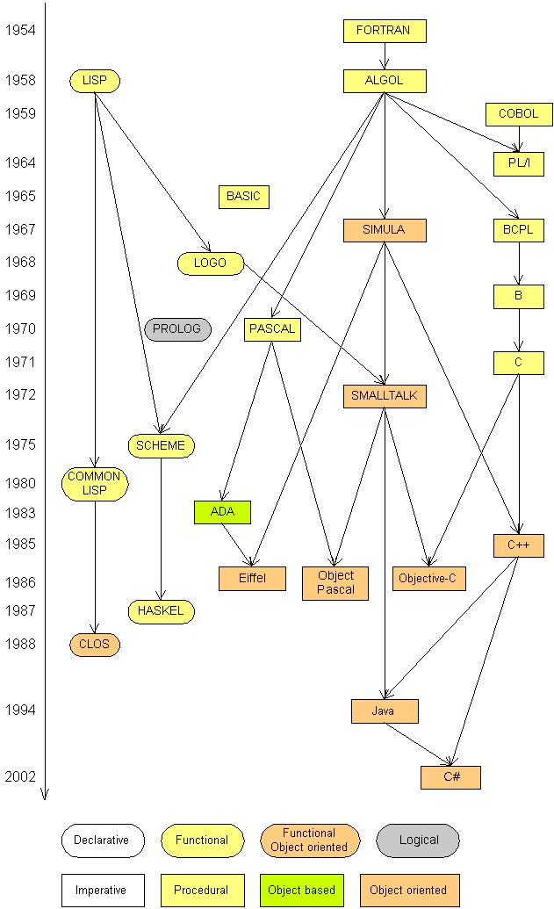
Languages
Some influential ones:
FORTRAN
science / engineering
COBOL
business data
LISP
logic and AI
BASIC
a simple language

Slide 52
Important links
My email: farhan.aadil@ciit-attock.edu.pk
My web page: DrAadil.com
Thanks for listening! Ready for Questions & Answers ☺

